Slide 1
A.R.T.S
Advanced Road Transportation
System

Slide 2
Prepared by: 1) Nikhil
2) Rahul
3) Krutika
4) Sagar
5) Laxmi
Guided by: Asha .Y mam

Slide 3


Slide 4
INDEX
Introduction
Block Daigrams
Application
Advantages

Slide 5
MOTIVE
ROAD
SAFETY
PUBLIC UTILITY
DETECTION
SYSTEM

Slide 6
ACCIDENTS IN INDIA
Total 5,50,835 Accident occur in india in 2016
Total no of death occur in the accident are 1,50,853
1 person dies in every 3 minute
16 children dies per day
411 people dies per day
Out of 100% person , 30% peoples dies
Overspeeding is the Leading cause for Accident
The cities are ranked according to accident
Chennai
Dehli
Bengalure
Kolkata

Slide 7
Accident Chart

Slide 8
ROAD
SAFETY
DETECTION
SYSTEM
1. ACCIDENT DETECTION
1. SPEED SENSOR
2. DRUNK & DRIVE
2. EMERGENCY BUTTON
3. RAINBOW CROSSING
3. FIRE DETECTION
PUBLIC
UTILITY
1.WIRELESS CHARGING
2.POWER GENERATION PAD

Slide 9
1.SPEED CONTROL SYSTEM
MOTOR
APR9600
AUDIO PLAYBACK
COMPARATOR
RELAY SWITCH
POWER SUPPLY
MOTORS

Slide 10
1.SPEED CONTROL SYSTEM
Speed limit are usually set to cap Road Traffic Speed.
Drivers who feel under Time Pressure have more motivation to travel faster.
When the driver cross the speed limit an alert message is created in form of voice signal.
More the 66% Accident occur due to overspeeding.

Slide 11
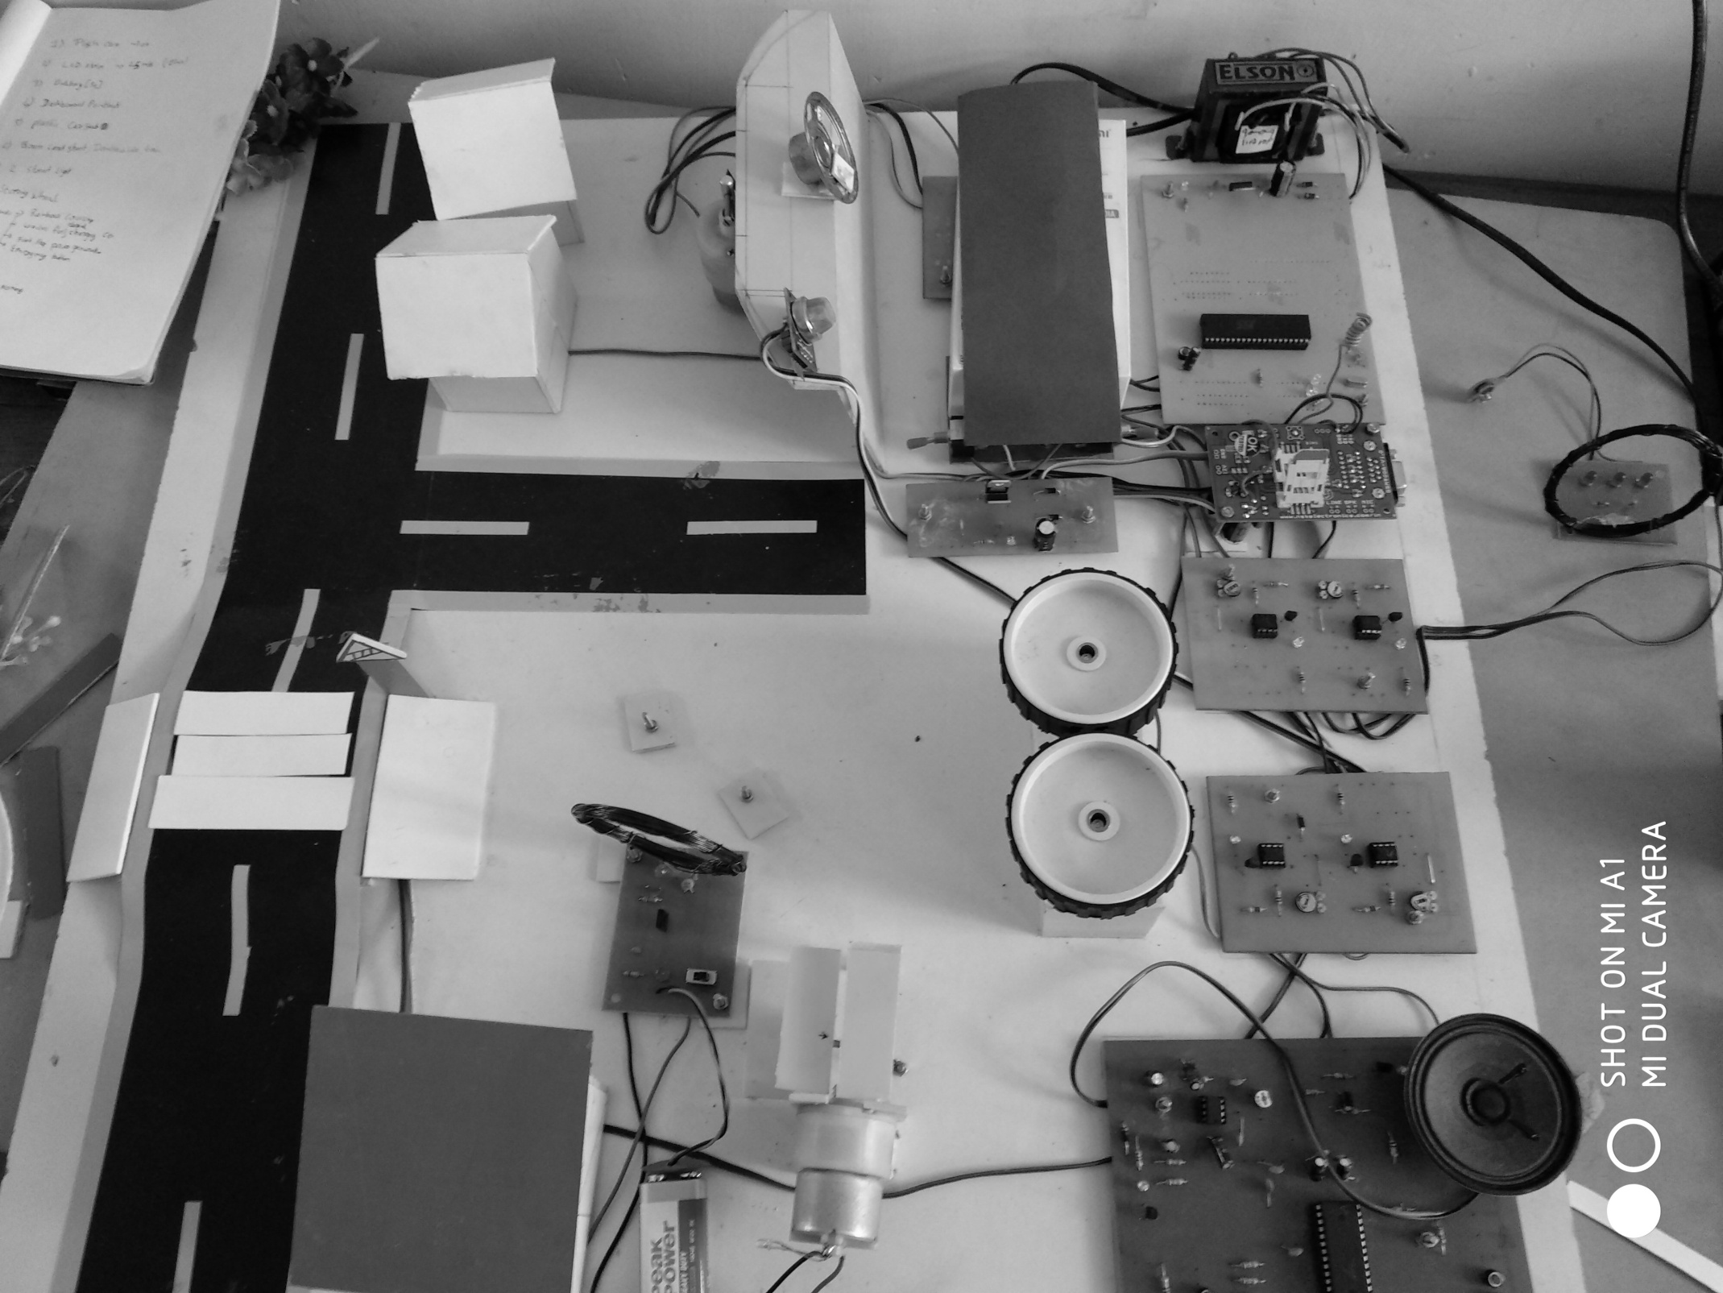

Slide 12


Slide 13
2.ALCOHOL DETECTION SYSTEM
MICROCONTROLLER
ALCOHOL SENSOR
GSM MODEM
COMPARATOR
IGNITION SYSTEM

Slide 14


Slide 15
2.ALCOHOL DETECTION SYSTEM
Drunk & Driving leads to the nearly 5% of accident
It detects the Alcohol content in Air
When a Alcohol is detected it Alert the Driver by Voice system and lock ignition

Slide 16
3.RAINBOW CROSSING
LIGHTS ON CROSSING
TIMER CIRCUIT
PRESSURE SENSOR
More then 60,000 accident occured in 2016 & 70% of them occured crossing the Road offside the zebra crossing.
Pedestrains can be viewed by Driver in night.
Pedestrains will be entertained to cross the Road.

Slide 17
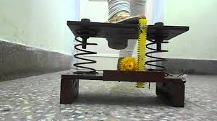

Slide 18
pads
dynamo
battery
4.Power Generation Pads
Utilize the pressure of the pedestrain to generate electricity.
It can be used at a Crowded place like Temple,railway station etc.
Genaration of Electricity is dependent on the Pedestrain Movement.
Generated energy can be used for lighting & etc

Slide 19


Slide 20
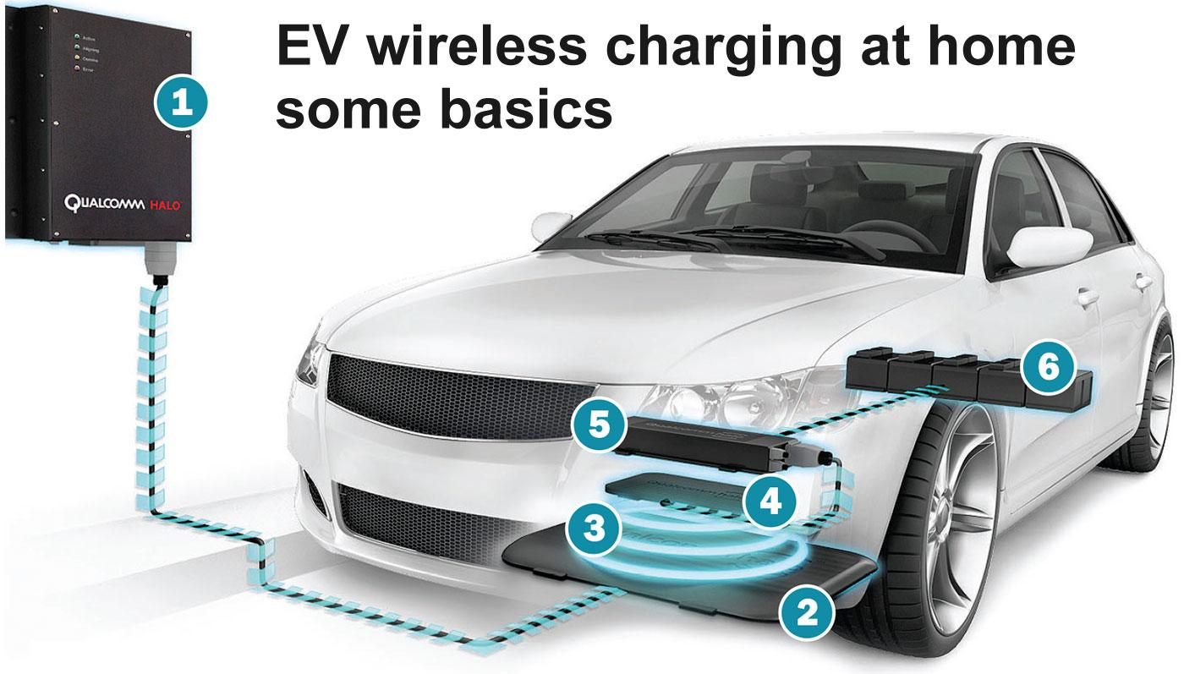

Slide 21
5.WIRELESS CHARGING
TRANSMITTER
MODULE
INDUCTION
COIL
AT PARKING
RECIEVER
MODULE
INDUCTION COIL
IN CAR
Approach to a new way of charging in aotumobiles
This uses an electromagnetic field to transfer electric energy between a transmitter circuit and a receiver circuit.
Elimination Wired charging

Slide 22


Slide 23
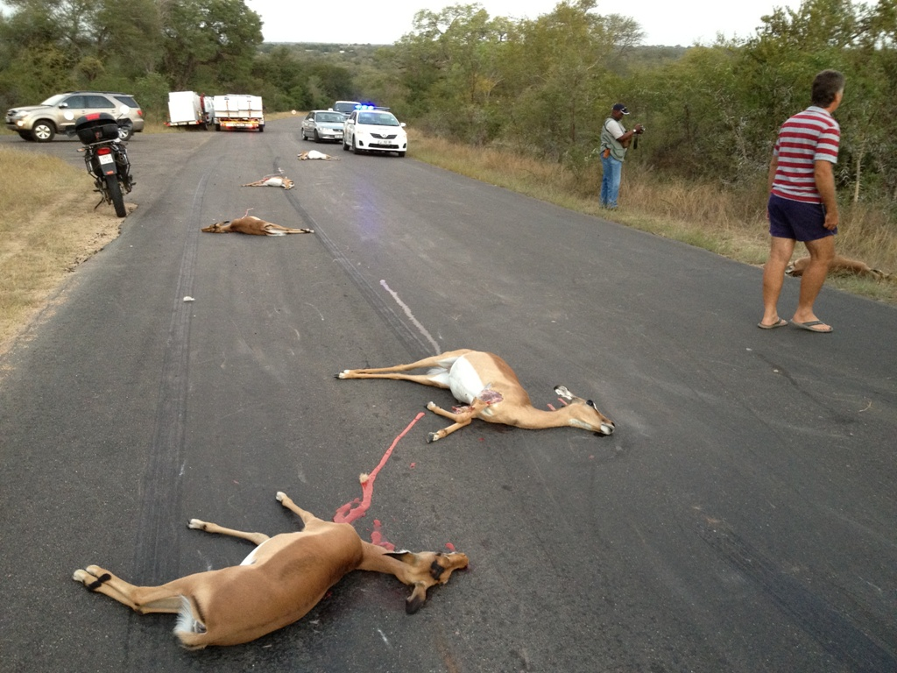

Slide 24
6.ACCIDENT DETECTION
VIBRATION
SENSOR
MICRO
CONTROLLER
FIRE SENSOR
GSM MODULE
SWITCH
AT STREETLIGHT

Slide 25
6.ACCIDENT DETECTION IN VEHICLE
Required Facility can be provide when the Accident occurs, Example Ambulance,Fire Extinguisher Etc.
Study on the total number of Accident occuring
Reduce the death of the Victim.
The Sector like Corportion,RTO,Police can get Information about Accidents.
At every 1KM a switch can be placed for intimation of accident.

Slide 26
ADVANTAGES
Generation of Electricity
Easy to travel for old peoples in crowded area
Reduce the Death of people
Reduction of Road Accident
Availibilty of Charging spot for Automobiles
Cleanliness is Maintained
Quick response of ambulance can be provided
Easy for old citizen to reach Destination in crowded Area
Enironment can be saved & pollution can be controlled

Slide 27
APPLICATIONS
Reducing Accident caused by Overspeeding.
Power Generation at a High Crowded Area,Roads,Steps,Temple etc.
Auto Accident Detection to provide the Amubulance Facility.
Accident Intimation to Corportation to maintan the City Clean.

Slide 28
APPLICATIONS
Study and Analysis of Co2 emission in the City.
Solar Powered Roadways to Genarate Non Conventional Power.
Reduces the Accident caused by Drunken Drivers.
Wireless Charging of Electric Automobile.

Slide 29
Thank You
For watching

